Slide 1
ausmif;jyifyrlvwef;ynma&;
'kwd,qifh
ocFsm
wefzdk;wltydkif;udef;rsm;oifenf;
a':arpDtkef;armif
(MLRC)

Slide 2
wefzdk;wltydkif;udef;rsm;
&nf&G,fcsuf
Munhf½Iavhvmjcif;? pOf;pm;qifjcifjcif; ESifh aqG;aEG;jcif;enf;wdkYjzifh wefzdk;wltydkif;udef;rsm; &Sm&ef oifMum;enf;udk jyefvnfazmfxkwfEdkif&ef

Slide 3
wefzdk;wltydkif;udef;rsm;
oifMum;rI&nf&G,fcsuf
1/ wefzdk;wltydkif;udef;rsm;qdkif&m enf;Oya'o rsm;udk azmfxkwfwwf&ef
2/ tydkif;udef;rsm;udk EIdif;,SOfwwf&ef
3/ tydkif;udef;qdkif&m taygif;? tEkwf ykpämrsm; ajz&Sif;wwf&ef

Slide 4
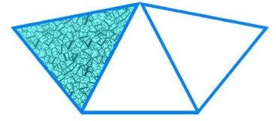

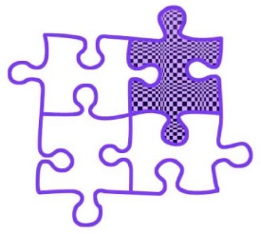
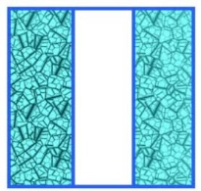


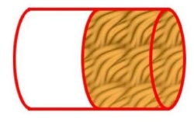

tajccHtodynmrsm;udkppfaq;jcif;
1/ atmufazmfjyygnDrQydkif;yHkrsm;\ ta&mifjc,fxm;aom tydkif;rsm; udkMunfhNyD; ay;xm;aom tydkif;udef;rsm;rStajzrSefudka&G;yg/
2
3
3
3
3
4
? ?
(u)
? ?
1
2
(*)
1
2
1
3
(c)
1
2
? ?
1
3
1
4
(C)
2
2
2
3
2
4
? ?
2/ ta&mifjc,fxm;aomtydkif;udk azmfjyonfh tydkif;udef; udka&;yg/
1
2
2
5
3
4
1
6

Slide 5

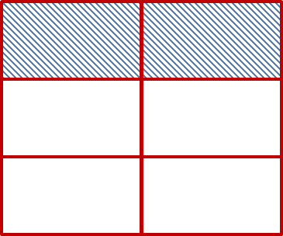
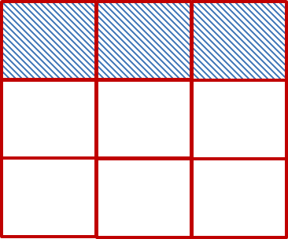
wpfck\tydkif;udef;rsm;
ay;xm;aom&G,fwlaxmifhrSefpwk*HyHkrsm;\ ta&mifjc,f xm;aomydkif;rsm;udkazmfjyyg/ (yHkrsm;udkavhvmyg/ yHkt& tydkif;udef;qufoG,fcsufudk azmfxkwfEdkifovm;/)
1
3
2
6
3
9
1
3
2
6
3
9
= =

Slide 6
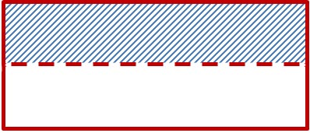

wpfck\tydkif;udef;rsm;
axmifhrSefpwk*HyHk (odkY) puf0dkif;yHkoP²mef&Sd pm&Guf udk,lyg/
rdrdpdwfBudKufnDrQydkif; 2 ydkif;acgufyg/
1 ydkif;udk ta&mifjc,fyg/ tydkif;udef;jzifhazmfjyyg/
1
2
1
2

Slide 7
wpfck\tydkif;udef;rsm;
¤if;acgufNyD;om;pm&Gufudkyif nDrQydkif; 2 ydkif;xyf acgufyg/ tydkif;udef;rsm;a&;yg/
1
2
2
4
1
2
2
4

Slide 8

wpfck\tydkif;udef;rsm;
tydkif;udef; rS &&efpm&Gufacguf&mwGif ta&mifxyfjc,f&ygovm;/ zsufvdkuf&ovm;?
1
2
2
4
rjc,f&yg/
rzsuf&yg/
rnfodkYaumufcsufcsEdkifoenf;/
tydkif;udef;rsm;wefzdk;wlonf/
ocFsmt& -
1
2
=
2
4

Slide 9
wpfck\tydkif;udef;rsm;
2
4
azmfjyaomyHkudknDrQydkif;rsm;xyfacgufyg/
2
4
4
8
2
4
4
8
ESifh wkYdwefzdk;wlonf/
2
4
4
8
ocFsmt& -
=

Slide 10
wpfck\tydkif;udef;rsm;
1
2
=
2
4
=
4
8
1
2
1 × 2
2 × 2
=
2
4
4
8
4 ÷ 2
8 ÷ 2
2
4
=
2
4
2 × 2
4 × 2
4
8
2
4
2 ÷ 2
4 ÷ 2
=
=
1
2

Slide 11
Oya'oazmfxkwfjcif;
yHkt& -
=
2
4
=
4
8
1
2
1 × 2
2 × 2
2
4
4
8
4 ÷ 4
8 ÷ 4
1
2
1
2
=
=
udef;*Pef;BuD;aom wefzdk;wl tydkif;udef;jzpf&ef ydkif;ajcESifhydkif;a0wdkYudk wlnDaomudef;jzifhajr§muf&rnf/
udef;*Pef;i,faom wefzdk;wl tydkif;udef;jzpf&ef ydkif;ajcESifh ydkif;a0wdkYudk wlnDaomudef;jzifhpm;&rnf/

Slide 12
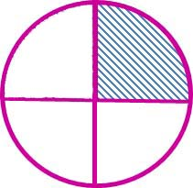
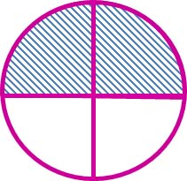
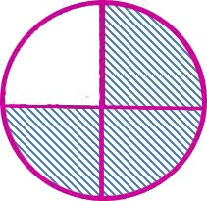
tydkif;udef;rsm;EIdif;,SOfjcif;
t&G,fwlpuf0dkif;yHk pm&Guf 3 &Gufudk,lyg/ nDrQydkif; 4 ydkif;pD acgufyg/ nDrQydkif; 1 ydkif;? 2 ydkif;? 3 ydkif; pDomta&mifjc,fyg/ yrmPudk EIdif;,SOfyg/
1
4
2
4
3
4
1
4
<
2
4
<
3
4
ydkif;ajcrsm;wlNyD; ydkif;a0rsm;rwlvQif ydkif;a0i,faomtydkif;udef;u ydkíi,fonf/

Slide 13

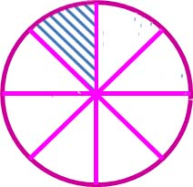
tydkif;udef;rsm;EIdif;,SOfjcif;
t&G,fwlpuf0dkif;yHk pm&Guf 3 &Gufudk,lyg/ 2 ydkif;? 4 ydkif;? 8 ydkif; toD;oD;acgufyg/ nDrQydkif;wpfckpDomta&mifjc,fyg/ yrmPudk EIdif;,SOfyg/
1
2
1
4
1
8
1
2
>
1
4
>
1
8
ydkif;a0rsm;wlNyD; ydkif;ajcrsm;rwlvQif ydkif;ajci,faomtydkif;udef;u ydkíBuD;onf/

Slide 14
tydkif;udef;rsm;EIdif;,SOfjcif;
4
5
3
4
ESifh wdkYudkEIdif;,SOfyg/
ydkif;ajcwlatmifñSdyg/wefzdk;wltydkif;udef;&Smyg/
4
5
4 × 4
5 × 4
=
16
20
3
4
3 × 5
4 × 5
15
20
=
16
20
>
15
20
∴
4
5
>
3
4

Slide 15



ydkif;ajcwlaomtydkif;udef;rsm;aygif;jcif;
yHkrsm;udkavhvmyg/ ocFsmjzifhazmfjyyg/
+
=
=
1
2
1
2
=
2
2
=
1
+
ydkif;ajcwlvQif ydkif;a0jcif;aygif;Edkifonf/
ydkif;ajcwpfBudrfomtoHk;jyKrnf/
ydkif;ajcESifhydkif;a0wlvQif 1 (wpfckvHk;jzpfonf/)
1
2
1
2
1 + 1
2
2
2
+
=
=
=
1

Slide 16
ydkif;ajcrwlaomtydkif;udef;rsm;aygif;jcif;
1
2
+
1
4
udk&Sif;yg/
+
=
1
2
+
1
4
=
3
4
ydkif;ajc 2 udk 4 jzpfatmifajymif;yg/
1 × 2
2 × 2
2
4
1
2
=
=
1
2
+
1
4
2
4
+
1
4
=
3
4

Slide 17
ydkif;ajcrwlaomtydkif;udef;rsm;aygif;jcif;
2
3
+
1
5
udk&Sif;yg/
2
3
=
2 × 5
3 × 5
=
10
15
1
5
1 × 3
5 × 3
3
15
=
=
∴
2
3
10
15
3
15
+
1
5
+
=
10 + 3
15
=
13
15

Slide 18
ydkif;ajcwlaomtydkif;udef;rsm;Ekwfjcif;
3
3
-
1
3
udk&Sif;yg/
-
=
3
3
-
1
3
=
2
3
3
3
1
3
3 - 1
3
2
3
-
=
=
ydkif;ajcwlygu ydkif;a0jcif;EkwfEdkifonf
ydkif;ajc 1 Budrfoma&;&onf/

Slide 19
ydkif;ajcrwlaomtydkif;udef;rsm;Ekwfjcif;
7
10
udk&Sif;yg/
-
1
6
7
10
7 × 6
10 × 6
42
60
=
=
1 × 10
6 × 10
10
60
1
6
=
=
7
10
42
60
10
60
-
1
6
=
-
=
42 - 10
60
32
60
8
15
=
=

Slide 20
7
10
udk&Sif;yg/
-
1
6
(wpfenf;)
7
10
7 × 3
10 × 3
21
30
=
=
ydkif;ajcudk 30 xm;yg/
1 × 5
6 × 5
5
30
1
6
=
=
7
10
21
30
5
30
-
1
6
=
-
=
21 - 5
30
16
30
8
15
=
=

Slide 21
wwfajrmufrIppfaq;jcif;
1/ ay;xm;aomtydkif;udef;\wefzdk;wltydkif;udef;udka&G;yg/ tajzrSef&Sdtu©&mudk tajza&;&efae&mwGifa&;yg/
(u) \wefzdk;wltydkif;udef;rSm --- jzpfonf/
(A) (B) (C) (D) (--)
2/ atmufyguGufvyfwGif = (odkYr[kwf) < (odkYr[kwf) > udk oHk;í EIdif;,SOfyg/
(A) ( ) 1 (B) ( )
(C) ( ) 1
3
4
(c)
4
+
2
=
6
4
3
6
4
3
8
6
8
2
+
4
=
6
3
3
1
5
1
3
5
3

Slide 22
oifMum;olrsm; odaumif;p&m
&nf½G,fwmudkoifyg?oifwmudkppfyg?
( nDrQydkif;upyg/ ) tydkif;udef;yHkrsm;rS pwifyg/ tydkif;udef; a&;ygap/
EIdif;,SOfavhvmygap/
avhvmcsufudkqifjcifygap/ aqG;aEG;ygap/
Oya'orsm;udk udk,fwdkifazmfxkwfygap/
(c)
4
+
2
=
6
2
+
4
=
6

Slide 23
oifMum;olrsm; odaumif;p&m
awGU&Sdcsufrsm;udk ykpämjyóemrsm; ajz&Sif;&mwGif a&G;cs,f toHk;jyKEdkifatmifavhvm avhusifhygap/ (nDrQydkif;^wefzdk;wltydkif;udef;^tydkif;udef;EIdif;,SOfcsuf)
tajccHtodynmcdkifrmygap/
(c)
4
+
2
=
6
2
+
4
=
6

