Slide 1
ausmif;jyifyrlvwef;ynma&;
yxrqifh
taygif;? tEkwfoifMum;jcif;
a':arpDtkef;armif
(MLRC)

Slide 2
taygif;? tEkwfoifMum;jcif;
&nf&G,fcsuf
avhvmaqG;aEG;jcif;enf;? udk,fwdkifqifjcif pOf;pm;jcif;enf; wdkYjzifh taygif;tEkwfqdkif&m oifcef;pmrsm;oifenf;udk azmfxkwfEdkif&ef?

Slide 3
taygif;? tEkwfoifMum;jcif;
oifMum;rI&nf&G,fcsuf
taygif;? tEkwfoabmESifh t"dyÜm,f udk azmfxkwfwwf&ef
taygif;? tEkwfykpämudk uRrf;usifpGmajz&Sif; wwf&ef

Slide 4
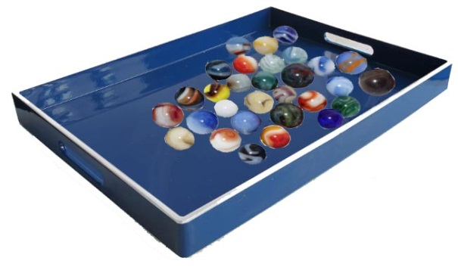
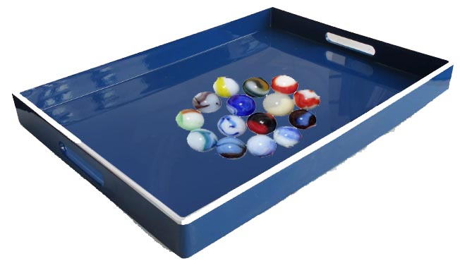
taygif;oabm
Aef; A ESihf Aef; B wdkYxJwGif a*:vDvHk;rsm;½Sdaeonf/ yrmPudkavhvmyg/
(A)
(B)
(1) rnfonhfAef;xJu a*:vDvHk;uydkrsm;aeovJ/
(2) Aef; A eJU B ESpfckvHk;rSm½SdwJhyrmPxufydkrsm;wJh a*:vDvHk;Aef;jzpf&ef?b,fvdkvkyf&rvJ/ (tjcm;ae&mrSr,l&)

Slide 5
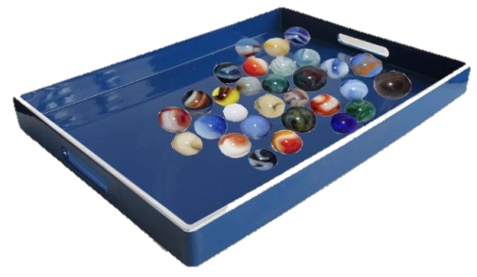
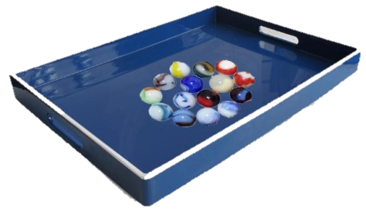



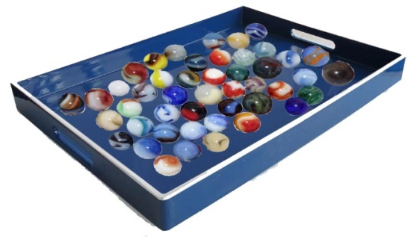
taygif;oabm
ajz½Sif;enf;
(A)
(B)
(A)
(B)
(A)
(B)
(A)
(B)
(A) + (B)
a&mjcif;^jznhfjcif;^aygif;vdkufjcif;
rlvxufydkrsm;vmonf/

Slide 6
taygif;oabm
zefcGuf A ESihf B wdkY½Sda&rsufESmjyifudkavhvmyg/
(A)
(B)
(1) rnfonhfzefcGufrSa&rsufESmjyifydkjrihfygovJ/
(2) zefcGufESpfcGuf½SdrlvrsufESmjyifrsm;xufa&rsufESmjyif ydkíjrihfvdkw,f/ b,fvdkaqmif½Guf&rvJ/

Slide 7
taygif;oabm
ajz½Sif;enf;
(B)
(A)
(A)
(B)
(A)
(A)
(A)
(A)
(B)
(B)
(A) + (B)
a&mjcif;^jznhfjcif;
rlvxufydkjrihfvmonf/

Slide 8
taygif;oabm
ajz½Sif;enf;
(A)
(B)
(A)
(B)
(A)
+
(B)
(A)
(B)
qufjcif;
rlvxufydk½Snfvmonf/

Slide 9
taygif;\t"dyÜm,f
(A) + (B)
(A) + (B)
ydkrsm;vmjcif;
ydkjrihfvmjcif;
(A)
+
(B)
(A)
(B)
ydk½Snfvmjcif;
taygif;onfwdk;vmjcif;jzpfonf/
oauFw (+)

Slide 10
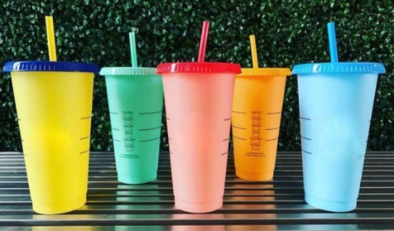
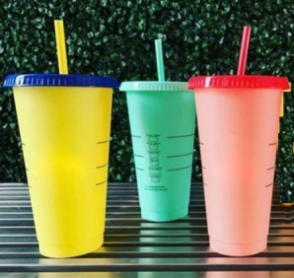
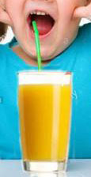

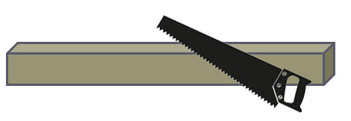
tEkwfoabm
cGJxkwfjcif;
avsmhenf;jcif;
jzwfjcif;

Slide 11
tEkwf\t"dyÜm,f
cGJxkwfjcif; ^ z,fxkwfjcif;
tEkwf
avsmhjcif; ^ jzwfjcif;
tEkwfonfavsmhoGm;jcif;jzpfonf/
oauFw (-)

Slide 12
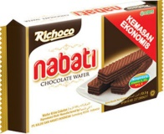
taygif;ykpämajz½Sif;jcif;
rkefYxkyf 3 xkyf½Sdonf/ 1 xkyfxyf0,fvmonf/ rkefYxkyf rnfrQ½Sdoenf;/
ay; rlv½SdrkefYxkyf
xyf0,frkefYxkyf
ar; rkefYb,fESxkyf½SdovJ/

Slide 13

taygif;ykpämajz½Sif;jcif;
ajz½Sif;enf;
+ , - ?
rlv½Sd
xyf0,f
xyf0,fawmhydkrsm;vm
rsm;awmhaygif; (+)
+
=
3
1
+
=
4

Slide 14
taygif;ykpämajz½Sif;jcif;
ausmif;om; 4 a,muf½Sdonf/ 1 a,mufxyfa&muf vmonf/ ausmif;om;b,fESa,muf&SdNyDenf;/
ay;
rlv½Sdausmif;om; 4 a,muf
xyfa&mufvmol 1 a,muf
ar;
b,fESa,muf½SdNyDvJ
ajz½Sif;
+ -

Slide 15
taygif;ykpämajz½Sif;jcif;
ajz½Sif;csuf
4
+
1
=
5
wnfudef;
aygif;udef;
aygif;v'f
taygif;oauFw
nDrQjcif;
a'gifvdkufaygif;jcif;
4
12
+
+
1
4
5
16

Slide 16
tEkwfykpämajz½Sif;jcif;
qyfjymt&nf 3 bl;½Sdonf/ 1 bl;ukefoGm;onf/ qyfjymt&nf bl;rnfrQusefoenf;/
ay;
rlv½Sdqyfjymt&nfbl; 3 bl;
ukefonhfqyfjymt&nfbl; 1 bl;
ar;
usefonhfqyfjym&nfbl; ?
ajz½Sif;
+ -

Slide 17
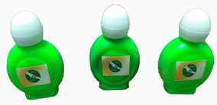
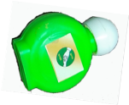
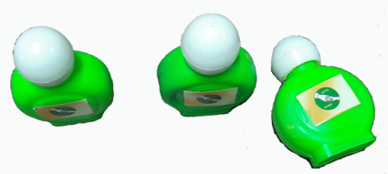
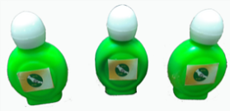
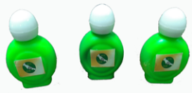



tEkwfykpämajz½Sif;jcif;
ajz½Sif;enf;
rlv½Sd
oHk;íukef
ukefawmhavsmhoGm;
avsmhoGm;awmhEkwf (-)
+ , - ?
-
=
3
-
1
=
2

Slide 18
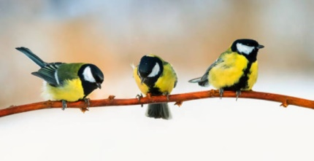
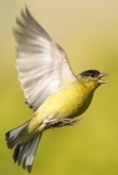
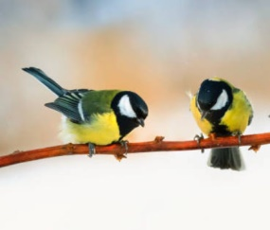
tEkwfykpämajz½Sif;jcif;
iSuf 3 aumifem;aeonf/ 1 aumifysHoGm;onf/ b,fESaumifom½Sdawmhoenf;/
ay;
rlv½SdiSuf 3 aumif
ysHoGm;onhfiSuf 1 aumif
ar;
usefonhfiSuf ?
ajz½Sif;
+ -

Slide 19
tEkwfykpämajz½Sif;jcif;
ajz½Sif;csuf
3
-
1
=
2
wnfudef;
Ekwfudef;
Ekwfv'f
tEkwfoauFw
nDrQjcif;
a'gifvdkufEkwfjcif;
3
29
-
-
1
15
2
14

Slide 20




wwfajrmufrIppfaq;jcif;
atmufygykpämrsm;udkajz½Sif;yg/
(1) yef;yif 2 yif½Sdonf/ 3 yifxyf&cJhonf/ yef;yifrnfrQ½Sd oenf;/
(2) Muufuav; 3 aumifaygufaeonf/ aemufxyf 1 aumif aygufvmonf/ Muufb,fESaumifaygufNyDenf;/
(3) ig; 4 aumif½Sdonf/ 2 aumifay;vdkufonf/ rnfrQusef oenf;/
(4) armifarmifwGifpmtkyf 5 tkyf½Sdonf/ eDeDudkpmtkyf 3 tkyf a&mif;vdkufonf/ armifarmifwGif pmtkyfb,fEStkyf om½Sdawmh oenf;/

Slide 21
oifMum;olrsm;odaumif;p&m
avhvmyg
oif,lolwdkY\aemufcHynmt&nftcsif;
oif,lol\oif,lrIt&nftaoG;
ajymif;vJEkdifonf
oifMum;enf;
oifMum;rIvkyfief;pOf
aqG;aEG;pOfowdjyK&ef
&nf&G,fcsufESifhudkufnDygap

