Slide 1



ausmif;jyifyrlvwef;ynma&; Zkefe,ftqifhenf;jyenf;jyoifwef;
(2020 jynfheSpf yxreSpf0uf)
ausmif;jyifyrlvwef;ynma&;jzpfay:wkd;wufrI
OD;wifndK?
'k Ouú|?
jrefrmekdifiHpmwwfajrmufa&;taxmuftuljyKyifrXme

Slide 2
&nf&G,fcsuf
ausmif;jyifya&mufuav;rsm;tajctaeudk azmfjywwf&ef
ausmif;jyifyrlvwef;ynma&;oabmobm0udk jyefvnf&Sif;jywwf&ef
ausmif;jyifyrlvwef;ynma&;vkyfief;atmifjrifrIudk&Sif;jywwf&ef
tydkif;(1) eSifh (2)&dSygonf

Slide 3
tydkif;(1)

Slide 4
ynmoif,lcGifh

Slide 5


ynmoif,lcGifh uav;wkdif;\arG;&mygtcGifhta&;
urÇmhvlUtcGifhta&;aMunmpmwrf; (tydk'f-26)

Slide 6
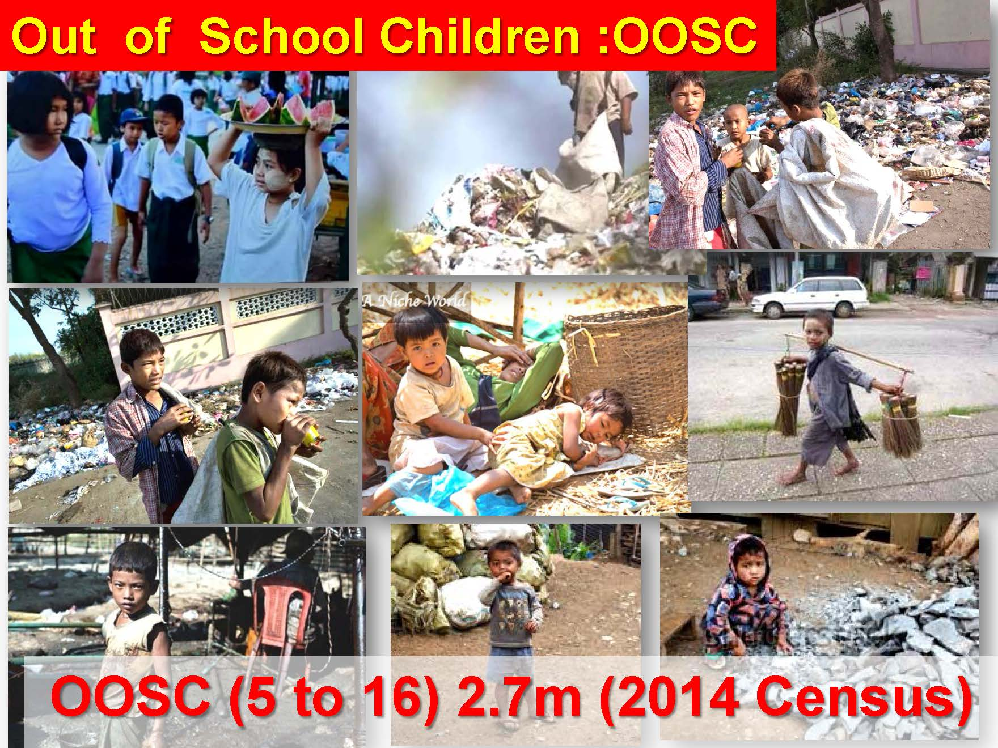


b0ay;aumif;aom uav;rsm;

Slide 7
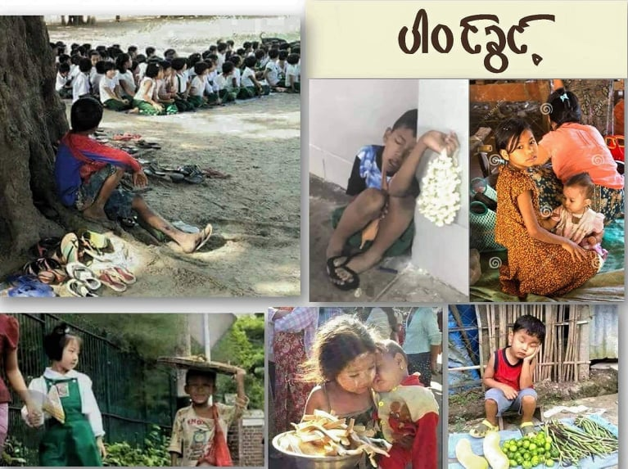
u,folrJhuav;rsm; b0eSifhqeö

Slide 8
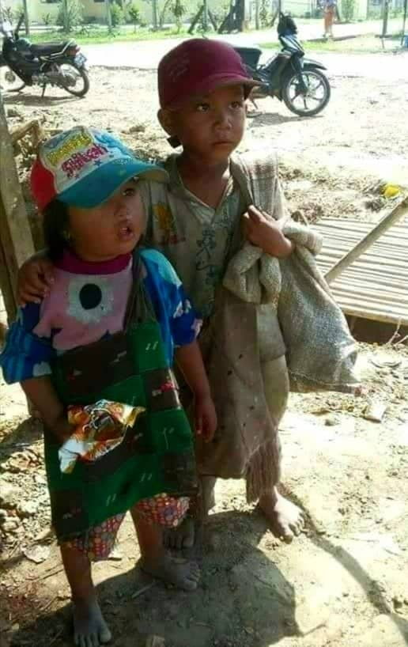
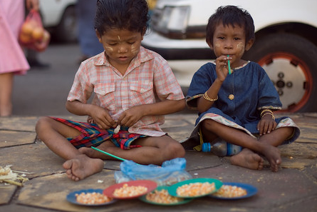
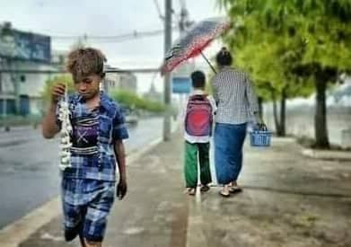
u,folrJhuav;rsm; b0eSifhqeö

Slide 9
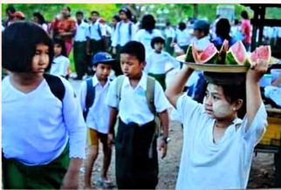
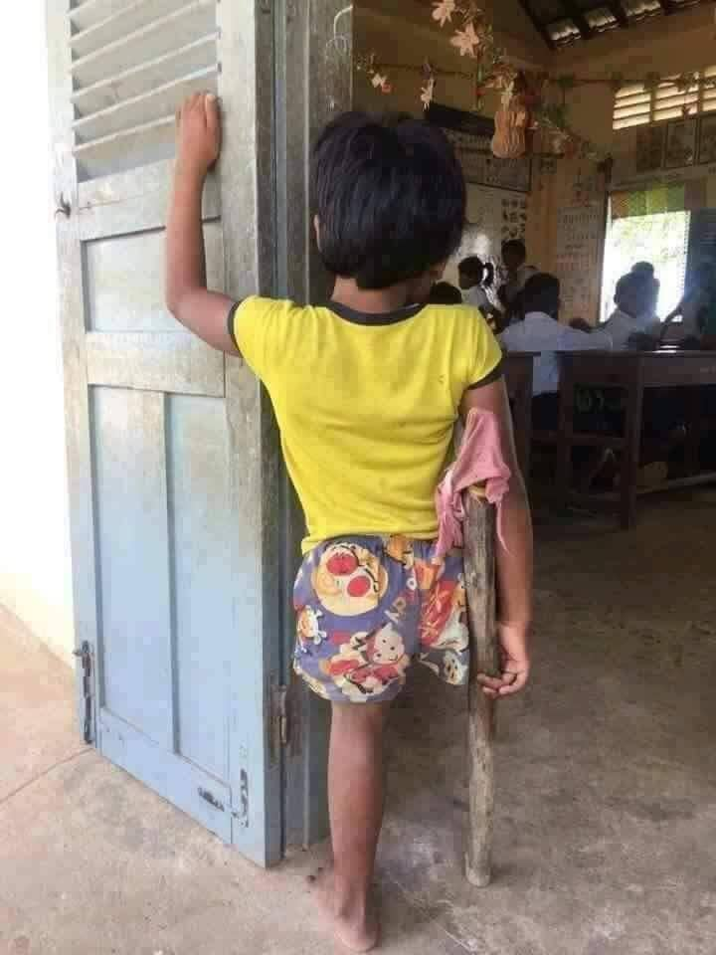

u,folrJhuav;rsm; b0eSifhqeö

Slide 10
Myanmar Population and OOSC
Year | Population (m) | OOSC(5-16) (m)
2014 | 51.4 | 2.7
2019 | 54.2 | Increase or Decrease ?
Myanmar (UIS) Data)
Indicator | 2014 | 2015 | 2016 | 2017
OOSC of PE age | 192,541 | - | - | 109,055
OOS adolescents and youths of PE n SE age | 2,933,593 | - | - | 1,951,061
OOS adolescents and youths of PE n SE age | 3,126,134 | - | - | 2,060,116
Source: Data extracted on 28-5-1915:00UTC from UIS
OOSC is considered as one of the key elements for education Index

Slide 11
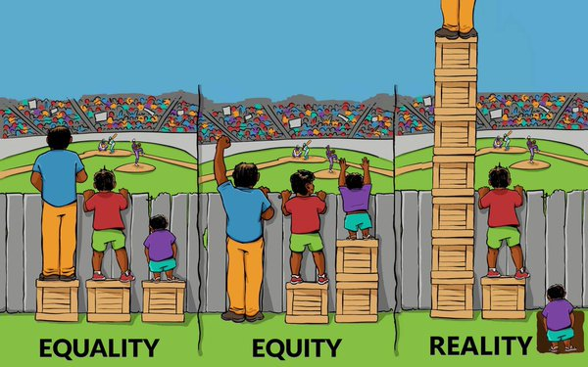
Equality, Equity and Reality
For everyone to attain the same benefit EQUITY is the key answer
Notes:
46 percent of allocated public resources benefit only 10 percent of the students - often students
who are already the most educated in low-income countries. Very few resources trickle down to
the region’s poorest children, including those living in remote and isolated areas, areas of conflict,
and urban slums

Slide 12
NFPE qdkonfrSm
&nf½G,fcsuf
  taMumif;trsKd;rsKd;aMumifh ausmif;vkH;0raecJh&zl;ao;ol?
  ausmif;aecJhaomfvnf;rlvwef;ynmrNyD;qkH;rDausmif;apm xGufcJh&ol?
  touf (10) ESpf rS (14) ESpf uav;rsm; udk
  'kwd,tBudrfynma&; tcGifhtvrf; jznfhqnf;ay;&ef?
  tajccHynmtv,fwef;qifhodkYqufvufoif,lcGifh&&Sd&ef?

Slide 13
NFPE qdkonfrSm
tqifh? wef;ñSdtpDtpOf (Equivalency )
  tqifh(1) onf rlvwef;atmufqifh
  tqifh(2) onf rlvwef;txufqifh
(Test Card jzifhqef;ppfí tqifh cGJjcm;onf)

Slide 14
NFPE qdkonfrSm
tcsdef eSifhae&m
  uav;rsm;vmzdkUtqiftajyqkH; tcsdef
  uav;rsm;vmzdkUtqiftajyqkH; ae&m
  (ausmif;?bkef;awmfMuD;ausmif;?"r®m&Hk? &yfuGuf&kH;)
q&m
  q&m q&mrrsm; (NFPE Teachers)

Slide 15
NFPE qdkonfrSm
oif,lol(uav;)
  ausmif;aecsifaomfvnf;ausmif;wufcsdefrSm taMumif;aMumif;aMumifhausmif; rwufEdkifol
  rdom;pkESifhrdrdudk,fwdkifb0udkcufcJpGmajz&Sif; ae&ol?

Slide 16
ausmif;ynma&; eSifhausmif;jyify ynma&;
rlvwef;
ausmif;raezl;ao;aom
uav;rsm;
ausmif;xGufuav;rsm;
ynma&;
'kwd,
tcGifhtvrf;
ausmif;jyifyrlvwef;ynma&;tpDtpOf

Slide 17
ausmif;ynma&; eSifhausmif;jyify ynma&;
rlvwef;
tv,fwef;
ausmif;raezl;ao;aom
uav;rsm;
ausmif;xGufuav;rsm;
NFME
CLC eSifh tjcm;
NFE vkyfief;rsm;
tMudKoufarG;vkyfief;rsm;
ynma&;
'kwd,
tcGifhtvrf;
ausmif;jyifyrlvwef;ynma&;tpDtpOf
a'ozGHUjzdKa&; taxmuftultpDtpOf

Slide 18

olwdkUtwGufoif,lcGifh
DO IT NOW Video zGifhyg
jyD;onfhtcg tydkif;(2) udkqufyg

